Slide 1
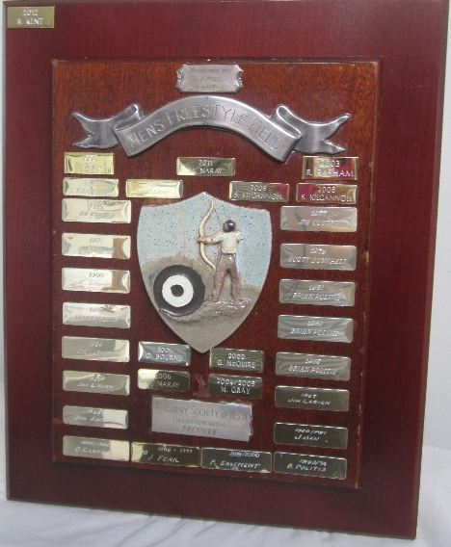
PRESS RELEASE
State Field Championships
16th & 17th April, 2022
Host-Armidale Field Archers
Perpetual Trophy for Outright winners awarded to the archer who has obtained the highest score at the State Field Championships in the following disciplines from the red peg.
Female Recurve
Ella-Rose Carson (Armidale Archers)
618 points
Male Recurve Nicholas Kyriazis (Northern Archers) 682 points
Male Compound: Dennis Carson (Armidale Archers) 780 points
Female Compound: Mollema, Alyssa (Warringah Archers) 708 points

